Slide 1
How to build a search engine(1)
Week2– get_page(url).py
2015/Apr/19

Slide 2
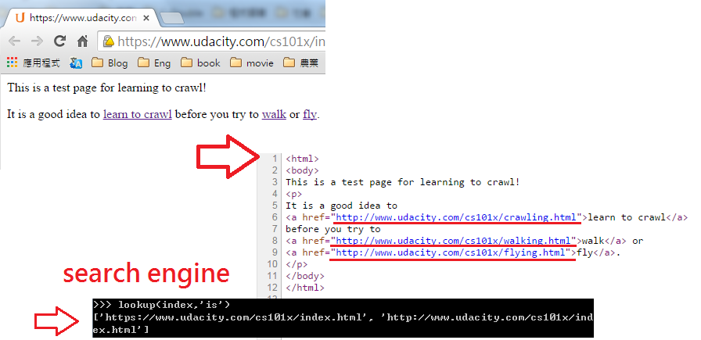
Goal→Crawl page
https://www.udacity.com/cs101x/index.html
To crawl every single keyword from one seed page

Slide 3
How to build?
Search Engine
Find data
Build an index
Rank page

Slide 4
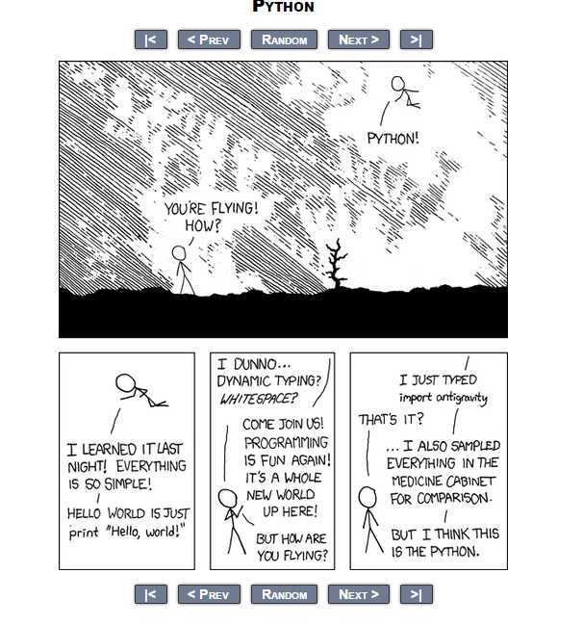
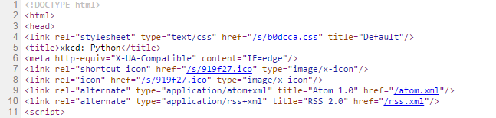
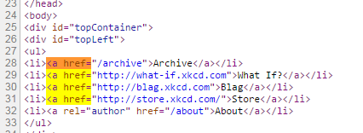
#1 How to find “keyword”
http://xkcd.com/353/

Slide 5


Syntax: <Str>.find(keyword,start_from)
→ Return the index of one string
→ Return -1 if not found

Slide 6
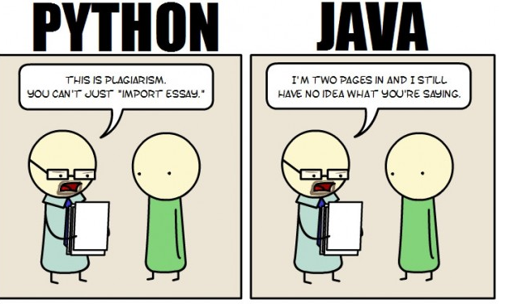
#2 import

Slide 7
Library
Python Standard Library
3rd party
twilio
OS
urllib
Class TwilioRestClient
def listdir
request
def rename
urlopen

Slide 8

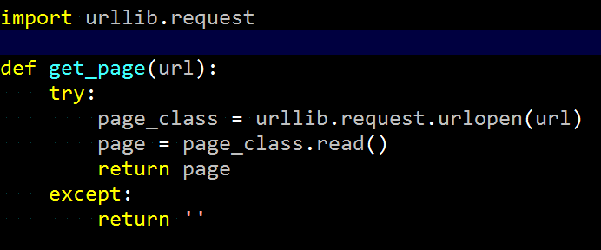
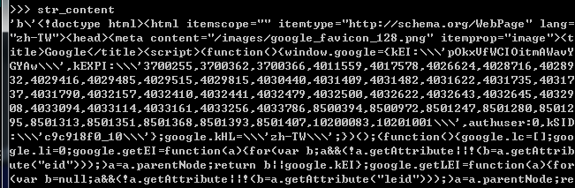
Synatx: urllib.request.urlopen(url)

Slide 9
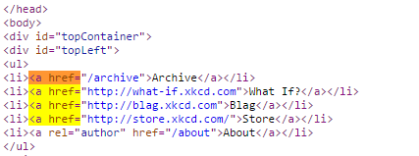
#3 get_next_target(page,search_index)

Slide 10
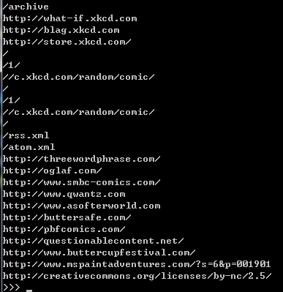
Homework
Try to finish this program(get_page_url.py):
Print out all of the hyperlink in a given page(http://xkcd.com/353/)

